Slide 1

Datta Meghe College of Engineering
Airoli, Navi Mumbai
Department of Information Technology
University of Mumbai
Academic Session : 2024 - 25
A Presentation
On
“NAVIZIT : THE SMART CITY GUIDE”
Presented By
DNYANESH.S.KHANDEKAR T.E., Semester 6, Div A, Roll No: 50
OMKAR.S.LANDE T.E., Semester 6, Div A, Roll No:60
PRATIK.D.KHODKA T.E., Semester 6, Div A, Roll No: 53
SAHIL.R.PAGARE T.E., Semester 6, Div B, Roll No: 16
Under the Guidance of
Mrs. Urmila Darekar

Slide 2
Content
Introduction
Literature Review
Problem Definition
Aim and Objectives
Proposed Methodology
Tech Stack
Time Frame
References

Slide 3
Introduction
The Smart Tourist Guide System for Mumbai City is a web-based platform designed to help tourists explore Mumbai with ease. This system offers tools like location search, weather condition, and enriched information about various attractions. Unlike basic mapping services, it provides detailed textual and pictorial content, helping tourists discover unique spots in the city.
Mumbai, known for its cultural richness and vibrant life, draws millions of visitors annually. The Smart Tourist Guide System enhances the travel experience by offering real-time information. It serves as a cost-effective alternative to traditional guides, enabling tourists to navigate the city confidently.
The Recommendation System in the Smart Tourist Guide suggests places to users based on their preferences and interests. It enhances the travel experience by providing personalized recommendations, making city exploration more efficient and enjoyable.

Slide 4
Literature Review
SR .NO | AUTHORS | TITLE | NAME OF JOURNAL/ PAPER | FINDINGS
1. | NB Nugraha, E Alimudin. | Tourist guide in Pekanbaru City. | Journal of Physics: Conference Series 1430 (1), 012038, 2020 | The system will use GPS to find the user point and can provide information about tourist attractions, hotels, restaurants and shopping.Google Maps API Was used.
2. | Rigobert Francis Buberwa, Anastazia Msusa. | Mobile gis tour guide app for dar-es-salaam city, Tanzania. | International Journal of Scientific and Technology Research 8 (4), 237-242, 2019 | "GIS and ICT Integration for Urban Navigation" shows that using these technologies together improves navigation in places with limited information. KNN algorithm was used.

Slide 5
SR .NO | AUTHORS | TITLE | NAME OF JOURNAL/ PAPER | FINDINGS
3. | U Nurhasan, H Pradibta, SB Suryadi, A Alfinda. | Malang city tourism potential using hybrid technology. | Journal of Physics: Conference Series 1402 (6), 066051, 2019. | Augmented reality effectively provides detailed and interactive information about local attractions in 3D visual format.Framework likes AR.js Or 8th wall.
4. | Chavan R, Bhoir M, Sapkale G, Mhatre A. | Smart Tourist Guide System. | Engpaper Journal. | Providing detailed location information, distance calculations, and weather updates, making it a cost-effective alternative to traditional guides.GPS was used.

Slide 6
SR NO. | AUTHORS | TITLE | NAME OF JOURNAL/ PAPER | FINDINGS
5. | J Jasman, M Ridwan, MKA Kamarudin, DP Lubis | Production Of Spatial Geosite Itinerary Maps as Tourism Destinations | Jurnal Geografi 15 (2), 208, 2023 | Tourist maps often lack comprehensive non-spatial attribute data essential for quality tourism experiences. This study addresses this limitation by developing spatial geosite itinerary maps that integrate geographical, cultural, and historical information.

Slide 7
SR NO. | AUTHORS | TITLE | NAME OF JOURNAL/ PAPER | FINDINGS
6. | Mohamed Badouch, Mehdi Boutaounte. | Personalized Travel Recommendation Systems: A study of Machine learning approaches in tourism. | Journal of Artificial Intelligence Machine Learning and Neural Network 33, 35-45, 2023. | This study analyzes accommodation booking data to predict customer review categories using machine learning. It explores recommender systems, including collaborative filtering, content-based filtering, and hybrid approaches.

Slide 8
SR NO. | AUTHORS | TITLE | NAME OF JOURNAL/ PAPER | FINDINGS
7. | Reem Alotaibi, Ahlam Ali, Haya Alharthi, Renad Almehamdi. | AI chatbot for tourist Recommendati-ons. | International Association of Online Engineering, 2020. | The build chatbot to serves as a single point of contact for tourists, providing recommendations for sights, hotels, activities, and full travel plans through a natural language interface.
8. | Adeel Munawar, Syed Ali Raza, Awais Qasim. | Design and Development of AI-Based Tourist Facilitator and Information Age-nt. | Applied Computer Systems 25 (2), 124-133, 2020. | The paper focuses on developing an AI-powered virtual tourist guide that mimics human facilitators by providing accurate travel information, natural communication, and real-time search capabilities.

Slide 9
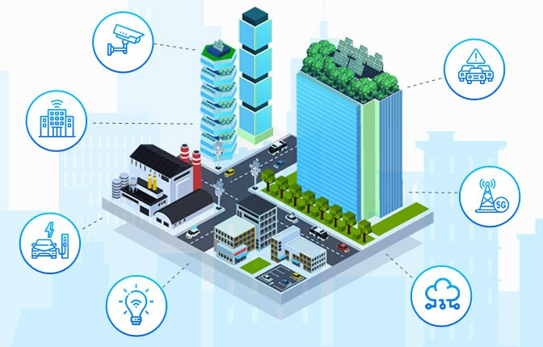
Problem Definition
Tourists and residents in Mumbai often find it difficult to access reliable information about the city's attractions, facilities, and events. This leads to inefficient planning and missed opportunities. The "Smart City Guide" solves this problem by offering a centralized platform with all the essential information in one place.

Slide 10
Aim And Objectives
Aim: To enhance the Smart City Guide by implementing a Machine Learning-based recommendation system that suggests top-rated tourist places, hotels, and restaurants based on user reviews and ratings, improving the user experience by providing relevant, highly-rated suggestions.
Objectives :
Implement an ML-based recommendation system that suggests top-rated places (tourist spots, restaurants, hotels) based on average ratings and user reviews.
Display highly-rated alternatives on location pages to help users discover the best places without manual searching.
Highlight the most highly-rated and reviewed locations dynamically to keep the homepage relevant and engaging.
Offer a simple, easy-to-use design so that everyone, including tourists and locals, can easily explore the city’s features.

Slide 11
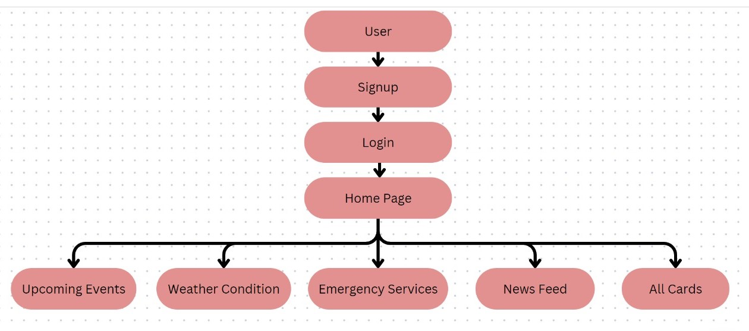
Proposed Methodology

Slide 12
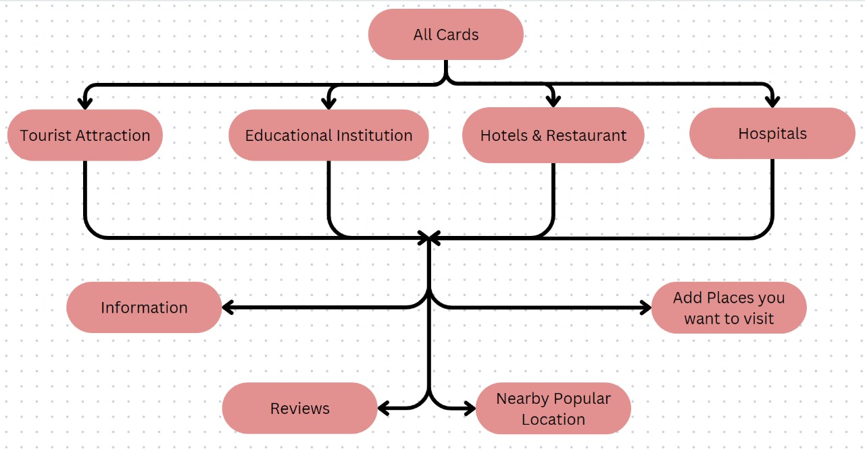
Flowchart

Slide 13
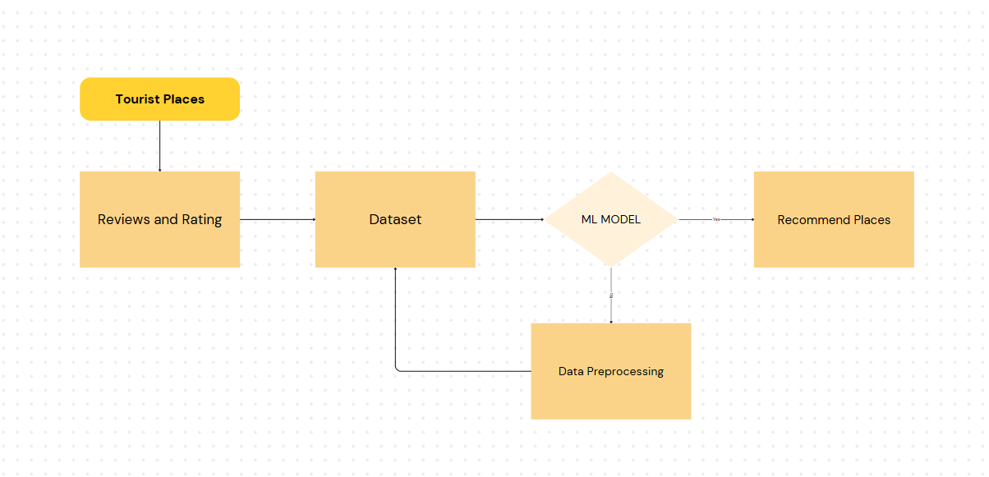
ML MODEL

Slide 14

Tech stack used
Frontend:React
Backend:NodeJs
Database:MongoDB
ML:Python libraries used numpy,pandas,google collab,flask

Slide 15
Time Frame (Planning) of completion of project
JANUARY | FEBRUARY
 | Week 1 | Week 2 | Week 3 | Week 4 | Week 5 | Week 6
Planning & Data Collection
Data Preprocessing
Model Selection & Training
Backend Integration
Review 1

Slide 16
MARCH | APRIL
 | Week 7 | Week 8 | Week 9 | Week 10 | Week 11 | Week 12
Frontend Integration
Real-Time Personalization
Verifying Program
Finishing the Final Touchups
Testing & Debugging
Review 2

Slide 17
References
[1] Nugraha, N. B., and E. Alimudin. "Mobile application development for tourist guide in Pekanbaru City." Journal of Physics: Conference Series. Vol. 1430. No. 1. IOP Publishing, 2020.
[2] Buberwa, R. F., & Msusa, A. (2019). Developing a mobile gis tour guide app for dar-es-salaam city, Tanzania. International Journal of Scientific and Technology Research, 8(4), 237-242.
[3] Chavan, R., Bhoir, M., Sapkale, G., & Mhatre, A. Smart Tourist Guide System. Engpaper Journal.
[4] Nurhasan, U., Pradibta, H., Suryadi, S. B., & Alfinda, A. (2019, December). Smart tourist guide application for the introduction of Malang city tourism potential using hybrid technology. In Journal of Physics: Conference Series (Vol. 1402, No. 6, p. 066051). IOP Publishing.

Slide 18
THANK YOU

